Slide 1
Network Layer :
Internet Protocol
20.<number>
Copyright © The McGraw-Hill Companies, Inc. Permission required for reproduction or display.

Slide 2

OUTLINE
Subnet wrto router perspective
Network Address Translation
Routing
  Routing Protocols
IPv6 Addressing
Transition from IPv4 to IPv6

Slide 3

Subnetting – Ex 2
Organization Block 17.12.14.0/26
  64 address
3 offices – to divide sub-blocks
  1st office – 32 address
  2nd office – 16 address
  3rd office – 16 address
/n = 26, /n1 = 27 , /n2=28, /n3=28

Slide 4

Figure 19.8 Three-level hierarchy in an IPv4 address
19.<number>

Slide 5

Figure 19.7 Configuration and addresses in a subnetted network
19.<number>

Slide 6
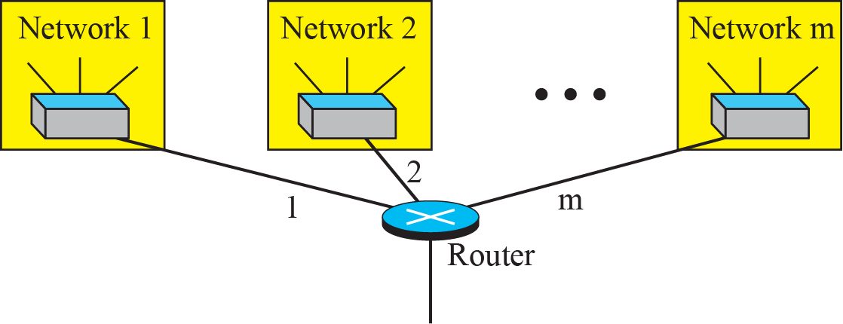
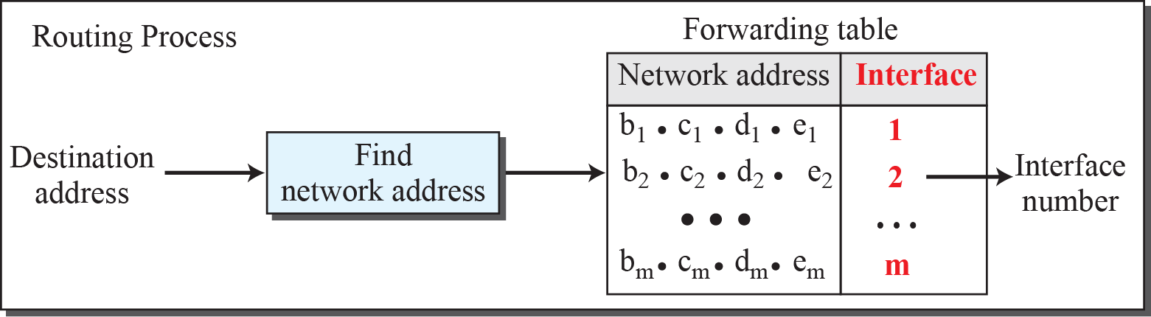
Figure 18.22: Network address
18.<number>
Notes:
18.#

Slide 7
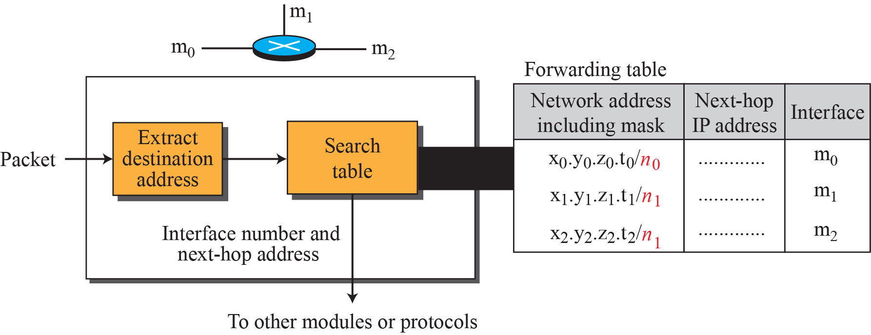
Figure 18.32: Simplified forwarding module in classless address
18.<number>
Notes:
18.#

Slide 8

Figure 22.5 Simplified forwarding module in classless address
In classless addressing, we need at least four columns in a routing table.
22.<number>

Slide 9

Internet – Connectionless Packet Switching Inter-Network
Packets in IPv4 called Datagrams
Communication at network layer connectionless
  Resource allocation on demand
  No reserved bandwidth on links, no scheduled processing time for each packet. Ex : Restaurant
N/W Layer protocol treats each packet independently
No relationship between packets
May/May not travel same path to destination
Datagrams could arrive out of order

Slide 10

N/W Layer : Direct vs Indirect Delivery
N/W Layer
  supervises handling of packets by underlying physical networks
  Data Delivery to final destination
  Direct
    Same physical network (SA & DA) (or)
    Delivery between Last router and destination host
    Sender extracts Network Address of Destination Address using mask and compares with directly connected network address
  Indirect
    Not on same network as deliverer
    Packet goes from Router to Router until reaches destination network

Slide 11

Figure 22.1 Direct and indirect delivery
22.<number>

Slide 12
N/W Layer : Forwarding Techniques
Forwarding requires
  Host or Router to have routing table
  Look for a route to destination
  Table lookup vs number of entries
Techniques
  Next Hop Method vs Route Method
    Only Next Hop Address vs Complete Route
  Network-specific vs Host Specific
    Reduce Routing table
    One single entity for same physical network
  Default Method
    Simplify routing

Slide 13

Figure 22.2 Route method versus next-hop method
22.<number>

Slide 14

Figure 22.3 Host-specific versus network-specific method
22.<number>

Slide 15

Figure 22.4 Default method
Host A connected
via 2 networks
22.<number>

Slide 16
Figure 22.5 Simplified forwarding module in classless address
22.<number>

Slide 17

Note
In classless addressing, we need at least four columns in a routing table.
22.<number>

Slide 18
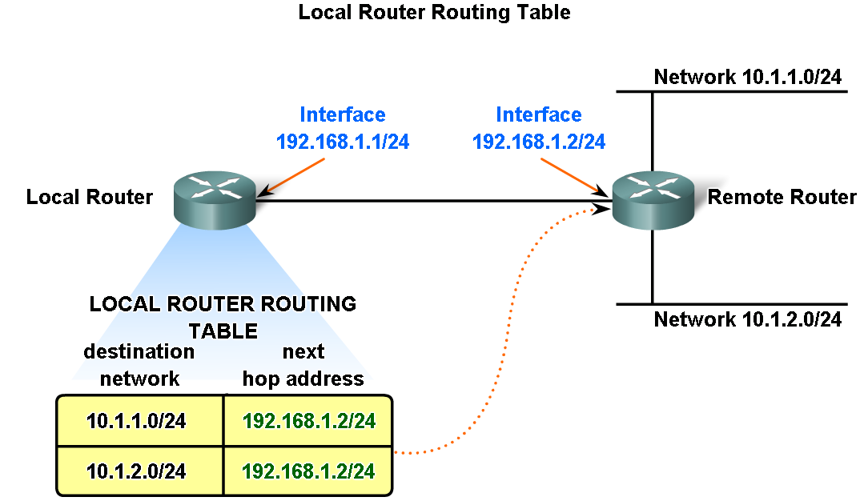
Fundamentals of Routes, Next Hop Addresses and Packet Forwarding

Slide 19
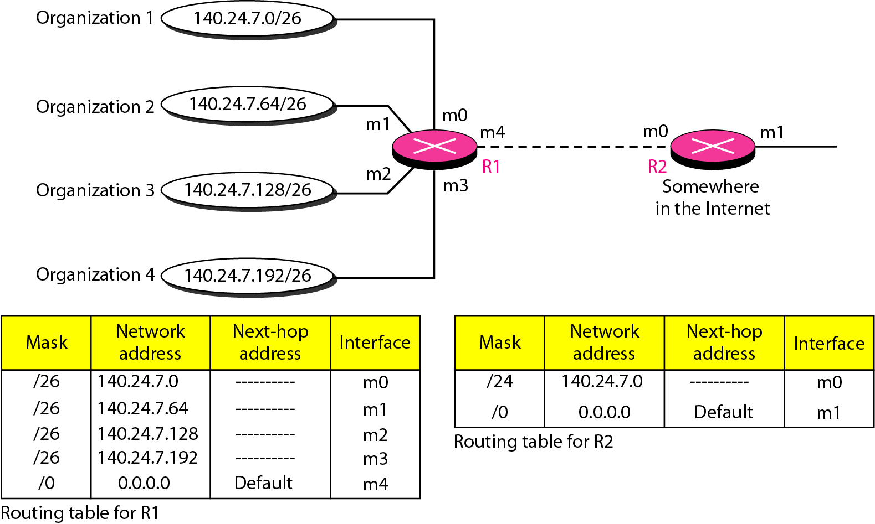
Figure 22.7 Address aggregation
Obtain Network Address from
Destination Address using Mask
22.<number>

Slide 20
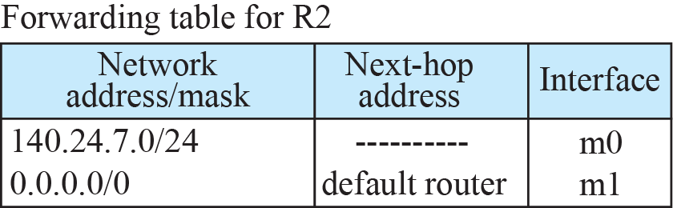
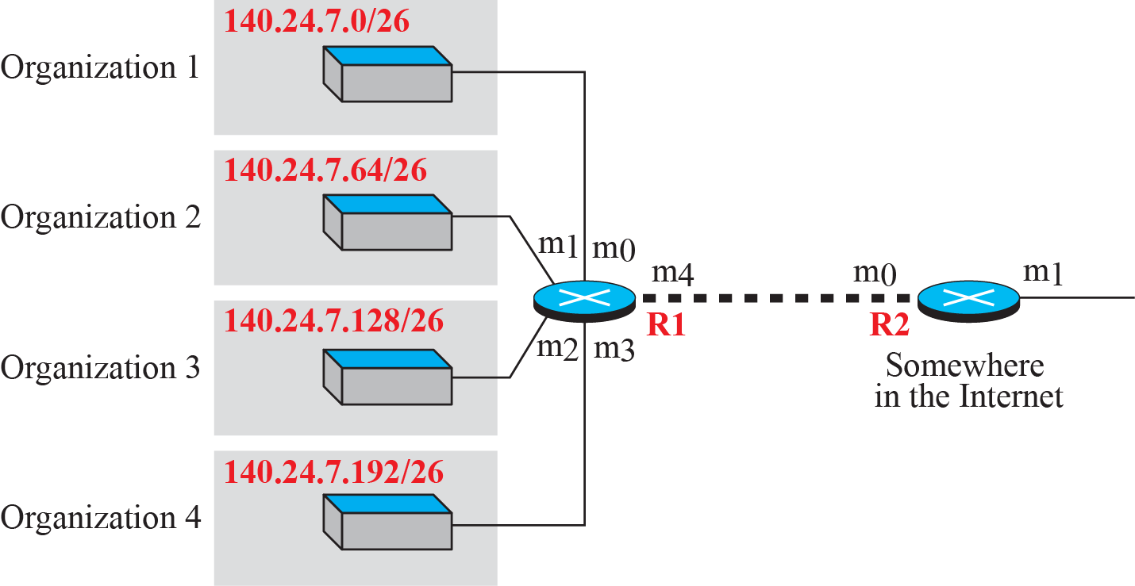


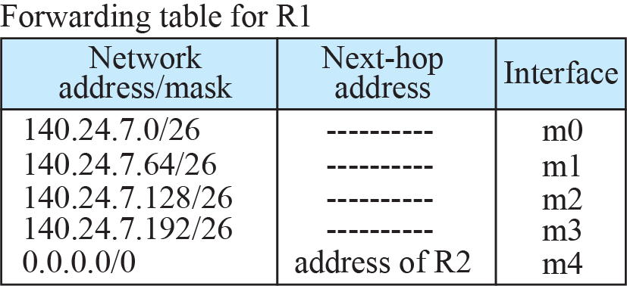
Figure 18.34: Address aggregation
18.<number>
Notes:
18.#

Slide 21
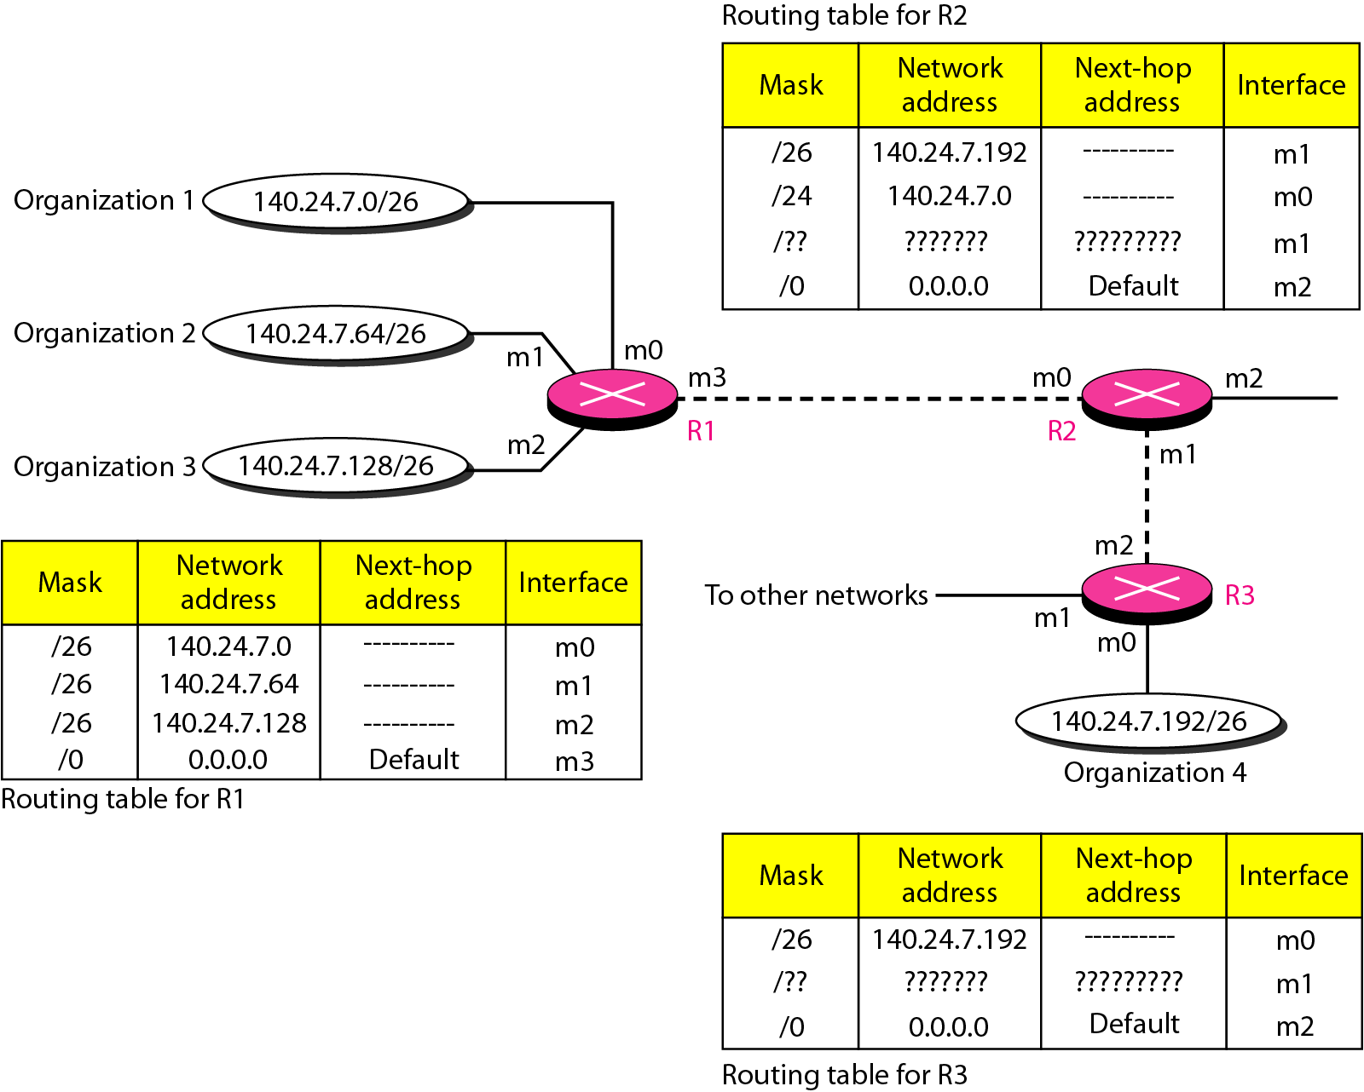
Figure 22.8 Longest mask matching
22.<number>

Slide 22
Routing Table
Routing Table
  Static
    Administrator – manual entries
  Dynamic
    Updated automatically when change somewhere in internet.
    Table updated as soon as there is change
    Ex : Router is down/ better route/ link failure

Slide 23
Routing Protocols
Routing Protocols
  Due to demand for dynamic routing tables
  Combination of rules/procedures
  Routers inform each other of changes
  Share whatever they know about neighborhood or internet
  Combine information received from other routers

Slide 24
Unicast Routing Protocols : Optimization
Router receives a packet
  Which network should it pass?
  Which of the available pathway is optimum?
  Optimization Decision
    Cost assigned for passing through network
    METRIC
    Depends on type of routing protocol
    RIP, OSPF, BGP etc…

Slide 25
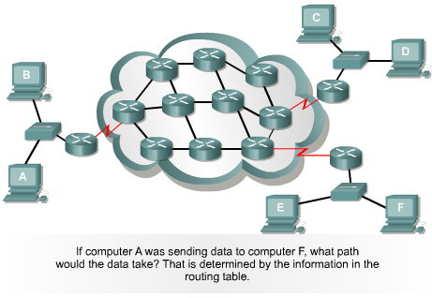
Path Determination Graphic

Slide 26


Routing Protocol
Router
Switch
Router
Router
Router
Switch
Router
What is
an optimal
route ?

Slide 27
Metrics
Hop count
  The number of times that a packet passes through the output port of one router
Bandwidth
  The data capacity of a link; for instance, normally, a 10-Mbps Ethernet link is preferable to a 64-kbps leased line
Delay
  The length of time that is required to move a packet from source to destination
Load
  The amount of activity on a network resource, such as a router or link
Reliability
  Usually refers to the bit error rate of each network link

Slide 28
Intra and InterDomain Routing
Difficult for one routing protocol to handle the task of updating routing tables of all routers
Divide internet into
  Autonomous Systems (AS)
    Group of networks and routers under authority of single administration

Slide 29

Figure 22.12 Autonomous systems
Routing inside AS
Routing between AS
22.<number>

Slide 30

Figure 22.13 Popular routing protocols
22.<number>

Slide 31
Distance Vector Routing
Least cost route between 2 nodes
  Route with minimum distance
  Ex : Cities – Roads
  Next-Hop Routing (Vector)
  Phases
    Initialization
    Sharing
    Updating
    When to Share?

Slide 32
Key features of Distance Vector Routing
The routers share the knowledge of the entire autonomous system
Sharing of information takes place only with the neighbors
Sharing of information takes place at fixed regular intervals

Slide 33

Figure 22.14 Distance vector routing tables
22.<number>

Slide 34


Figure 22.15 Initialization of tables in distance vector routing
Phase1 : Initialization
Immediate neighbors directly connected. Others Unreachable (infinity)
22.<number>

Slide 35

Phase2 : Sharing
Share the entire table to neighbor?
Ans : next node is sender, 2 columns only
Note
In distance vector routing, each node shares its routing table with its
immediate neighbors periodically and when there is a change.
22.<number>

Slide 36


Figure 22.16 Updating in distance vector routing
Phase3 : Updating
Add sending node as next-hop
Next hop for same destination
different, take smaller cost
same, Choose new row
Tie?
22.<number>

Slide 37
Phase 3 : Updating
Next-hop entry is same,
  Ex : node C previously advertised route to node X (Distance 3) (Old route)
  Link fails, Node C --- Node X (Distance ∞ ) (new route).
  Node C advertises this new route now.
  Which one to take?

Slide 38
When to Share?
  Periodic Update
    30 seconds
    Depends on the Distance vector Routing Protocol
  Triggered Update
    Any time if change in routing table
    Receives table from neighbor and changes in own table after updating
    Failure in neighboring links results in distance ∞

Slide 39

Two Node Loop Instability
  Network Becomes Unstable?
  Suddenly link failure between A & X
  What if B sends routing table to A before A can send? – instability scenario

Slide 40

Figure 22.17 Two-node instability
2 node loop problem
22.<number>

Slide 41
Solutions to 2 node loop problem
Defining Infinity
  Redefine ∞ to say 100
  System will become stable in less updates
  Distance taken as 1 between each node
  Infinity = 16
  Limitations : Size of network cannot exceed 15 hops

Slide 42
Solutions to 2 node loop problem contd..
Split Horizon
  Way to eliminate routing loops
  Speed up convergence
  prevents a router from advertising a route back out the same interface where the router originally learned the route
    Send part of table through each interface
    B knows optimum route to reach X via A , eliminate sending in same interface (A already knows)
    Don’t create confusion

Slide 43
Solutions to 2 node loop problem contd..
3. Poison Reverse
  Route poisoning enables the receiving router to advertise a route back toward the source with a metric higher than the maximum (Infinity).
  Infinity as Warning : “Do not use this value, What I Know about this route comes from you”
  Why? Split Horizon Drawback : Timer for every route in DV. Delete route if no news

Slide 44
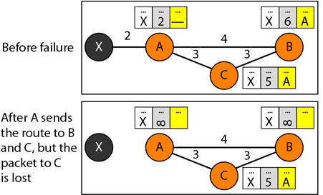
Figure 22.18 Three-node instability
Cannot be guaranteed for stability
22.<number>

Slide 45
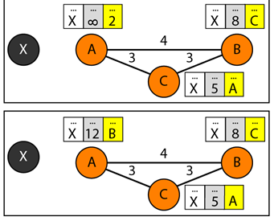


Figure 22.18 Three-node instability
A will not advertise
back to B but will to C.
Loop continues.
22.<number>

Slide 46
Routing Information Protocol (RIP)
Intradomain routing protocol used inside autonomous system
Based on Distance Vector Routing
Metric in RIP
  Hop Count (distance = no of links (networks) to reach destination)
  Infinity = 16 in RIP
  Route in an AS using RIP cannot have more than 15 hops.

Slide 47
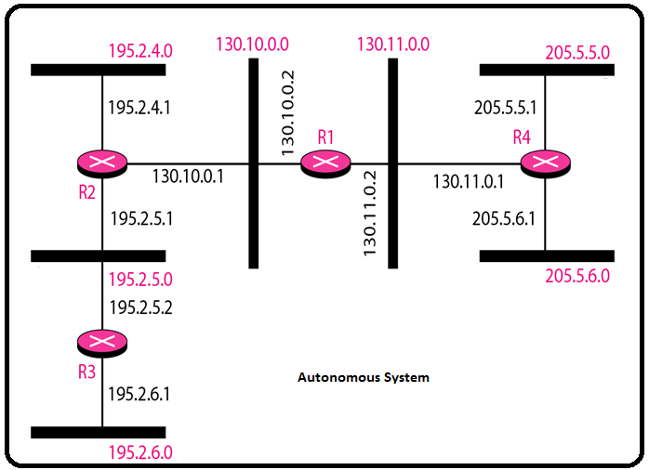
Figure 22.19 Example of a domain using RIP
22.<number>

Slide 48

Figure 22.19 Example of a domain using RIP
22.<number>

Slide 49
Link State Routing
Each node obtains entire topology of the domain
  List of nodes and links
  How they are connected including
    Type of Link
    Cost (metric) of links
    Condition of Link (up/down)
  Node uses Dijkstra’s Algorithm to build routing table

Slide 50
Link State
Link-state defines the characteristic of a link (an edge) that represents a network
LS protocols will take a path which may have more hops, but that uses a faster medium over a path using a slower medium with fewer hops.
Links with lower costs are preferred to links with higher costs;
If the cost of a link is infinity, it means that the link does not exist or has been broken

Slide 51

Figure 22.20 Concept of link state routing
Every router has knowledge about the network, but from its own perspective. Ex : City Map
22.<number>

Slide 52
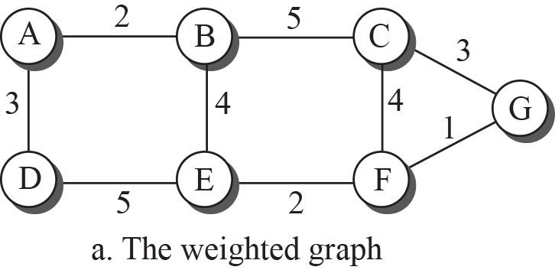
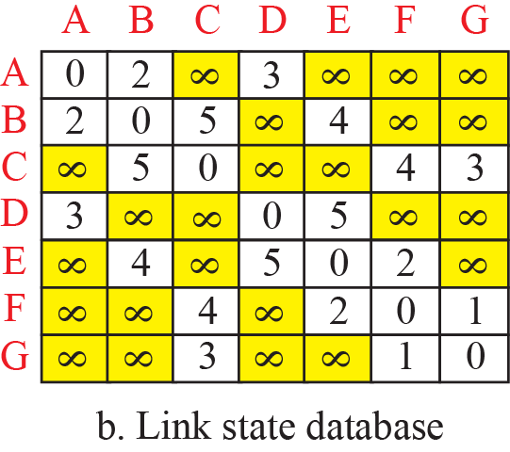
Figure 20.8: Example of a link-state database
20.<number>
Notes:
20.#

Slide 53
Link State vs Distance Vector
In distance vector
  Each Router tells its neighbors what it knows about the whole AS
In Link State
  Each Router tells the whole AS what it knows about the neighbors

Slide 54
Dynamic Topology maintenance
Latest state of each node & link
  Dynamic Topology
  Any change in any point in network (Ex : Link down)
    Updated topology at each node?
    No node can know topology at beginning or after change somewhere in network
Global Knowledge about topology not clear
  Using Partial Knowledge compile whole topology

Slide 55

Figure 22.21 Link state knowledge
22.<number>

Slide 56
Link State Routing
The routers share the knowledge only about their neighbors compared to all the routers in the autonomous system
Sharing of information takes place only with all the routers in the internet, by sending small updates using flooding compared to sending larger updates to their neighbors.

Slide 57

Building Routing Tables
1) Creation of the states of the links by each node, called the link state packet (LSP)
2) Dissemination of LSPs to every other router, called flooding, in an efficient and reliable way
3) Formation of a shortest path tree for each node
4) Calculation of a routing table based on the
shortest path tree

Slide 58
Creation of LSP
LSP
  Advertiser ID, Sequence Number, List of neighbors (Cost of Link) etc.
  Seq No
    Distinguish new LSPs from Old ones
When generate LSPs?
  When there is a change in the topology of the domain
    Triggered update
  On a periodic basis but > DV
    60 minutes or 2 hours

Slide 59
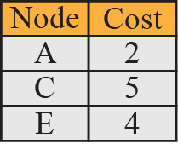
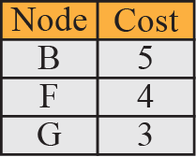
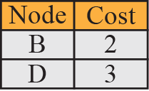
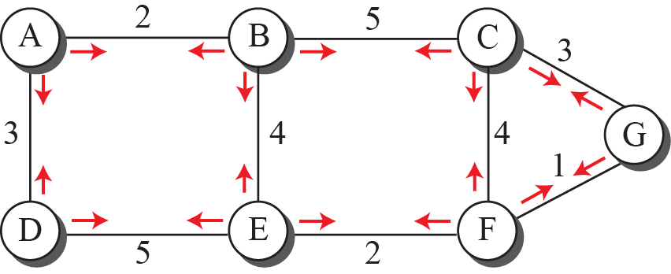
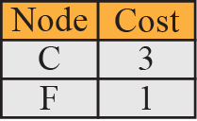
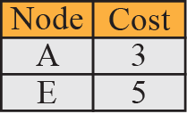
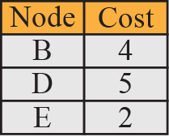
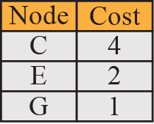
Figure 20.9: LSPs created and sent out by each node to build LSDB
20.<number>
Notes:
20.#

Slide 60
Flooding of LSPs
Dissemination of LSPs to every other router, called flooding
A node that receives an LSP compares it with the copy it may already have.
  If the newly arrived LSP is older than the one it has, it discards the LSP.
  If it is newer,
    the node does discard the old LSP and keep the new one
    It sends a copy of it out of each interface except the one from which the packet arrived
  Guarantees that flooding stops somewhere in the domain (where node has only one interface)

Slide 61
Figure 20.8: Example of a link-state database
20.<number>
Notes:
20.#

Slide 62

Figure 22.22 Dijkstra algorithm
22.<number>

Slide 63
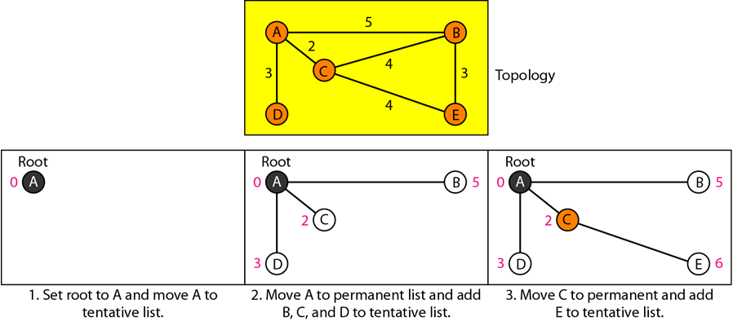
Figure 22.23 Example of formation of shortest path tree
22.<number>

Slide 64
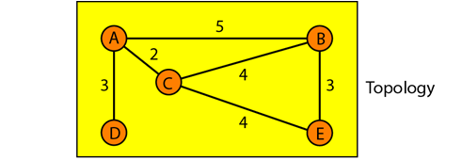
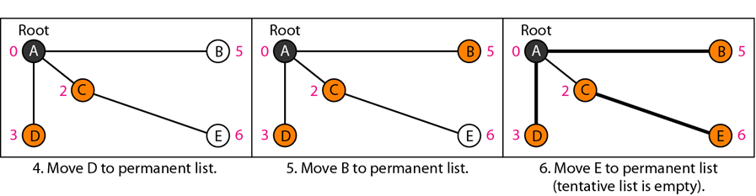
20.<number>

Slide 65

Table 22.2 Routing table for node A
22.<number>

Slide 66
Figure 20.8: Example of a link-state database
20.<number>
Notes:
20.#

Slide 67

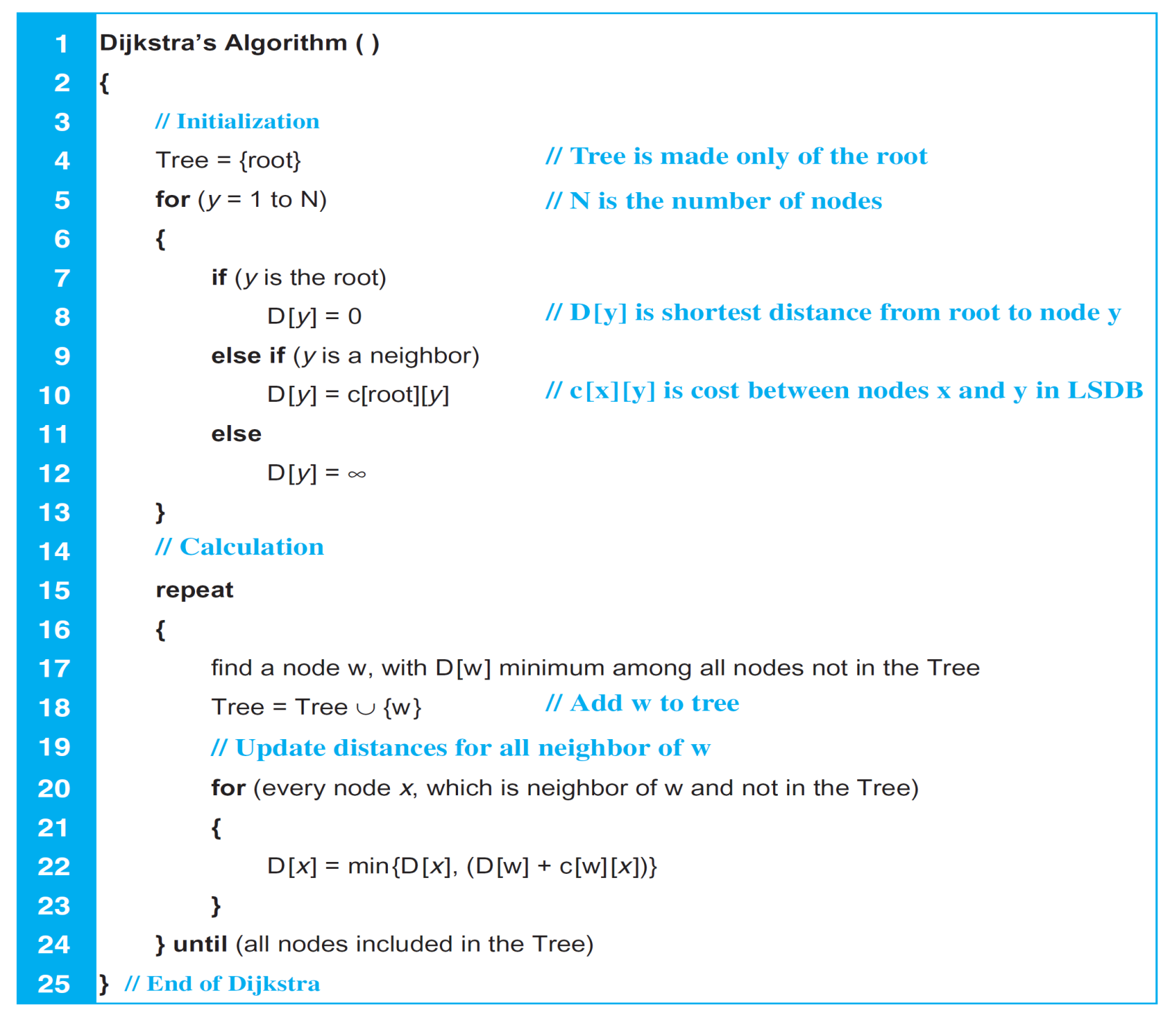
Table 20.2: Dijkstra’s Algorithm

Slide 68
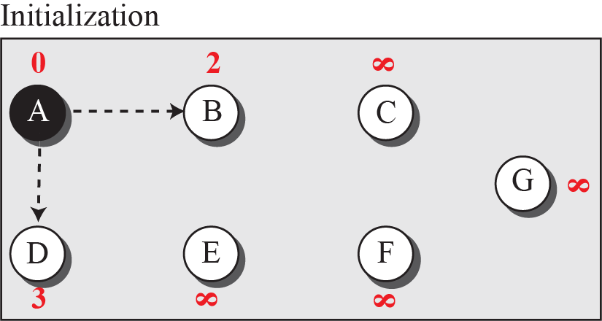

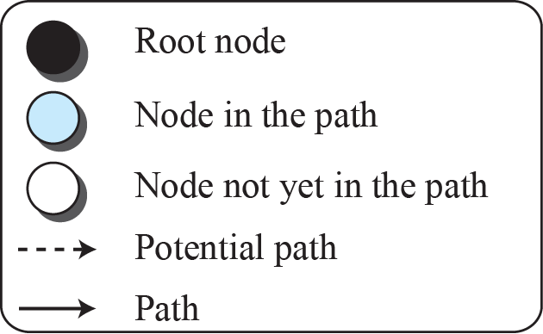
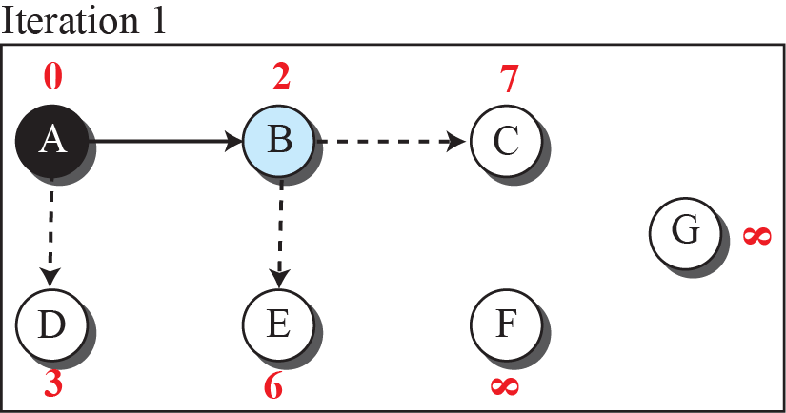
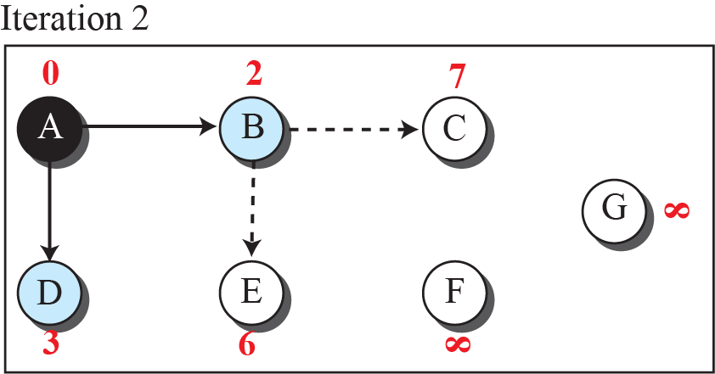
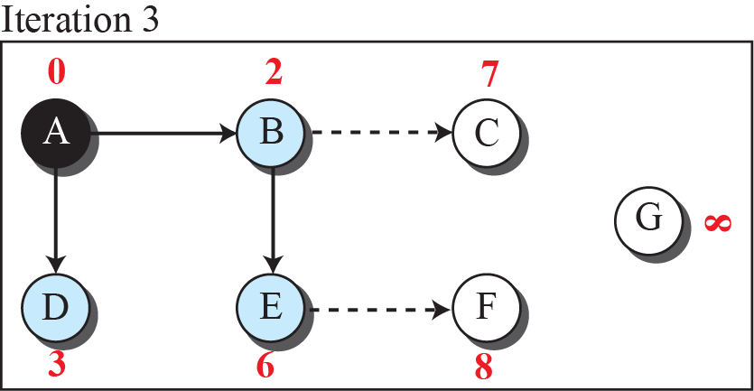
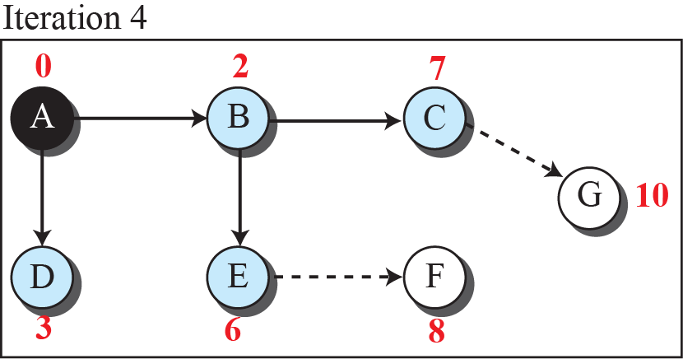
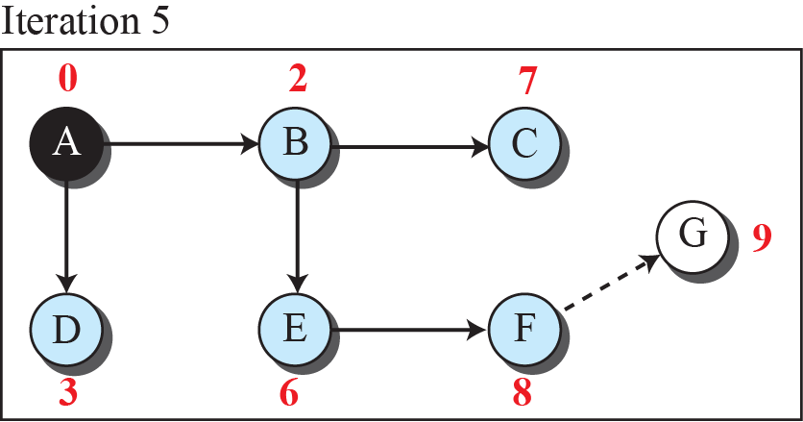
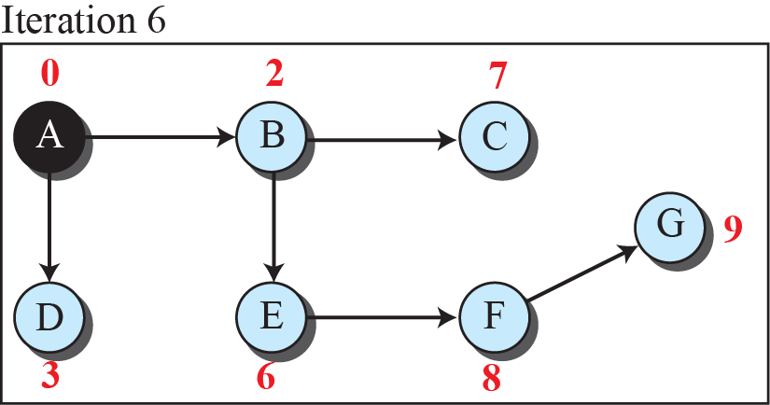
Figure 20.10: Least-cost tree
20.<number>
Notes:
20.#

Slide 69
OSPF (Open Shortest Path First)
Open Shortest Path First (OSPF) protocol
  intradomain routing protocol based on link state routing.
  Its domain is also an autonomous system
  RIP was increasingly incapable of serving large, heterogeneous internetworks
  OSPF being a SPF algorithm scales better than RIP.
  This protocol is open, which means that its specification is in the public domain.
  It means that anyone can implement it without paying license fees.

Slide 70
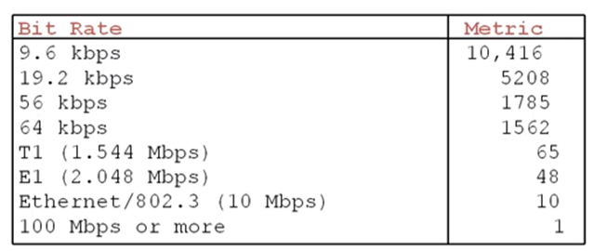
Metrics (Cost) – OSPF depending on TOS
Administrator can assign cost to each route
Ex : Metric = 10⁸/Speed

Slide 71
OSPF (Open Shortest Path First)
Prevent routers flood the whole AS with their LSPs to create global LDSB
Dividing an AS into areas
  to handle routing efficiently and in a timely manner
  Small independent domain for flooding LSPs.
  Another level of hierarchy – Area ;
  1st level – AS ; 2nd level - Area

Slide 72

OSPF (cont’d)
Areas
  Is a collection of networks, hosts, and routers in AS
  AS can be divided into many different areas.
  All networks inside an area must be connected.
  Routers inside an area flood the area with routing information.
Area Border Router
  Summarizes the information about the area and sends it to other areas
Backbone
  All of the areas inside an AS must be connected to the backbone
  Serving as a primary area, others as secondary
  Consisting of backbone routers
  Back bone routers can be an area border router

Slide 73
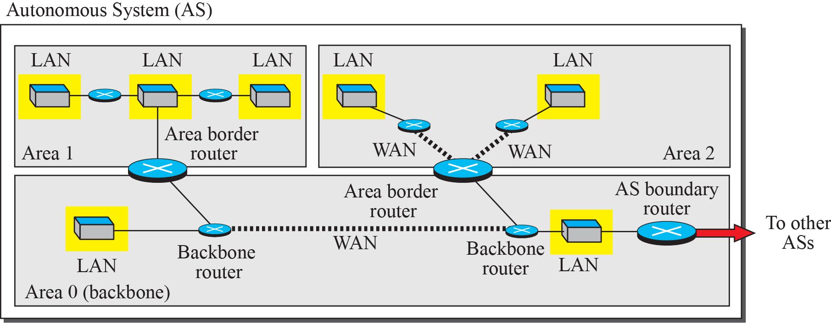
Figure 20.21: Areas in an autonomous system
Each Area has an Area ID
Area ID of Backbone is zero
Notes:
20.#

